Slide 1













Personal Finance Management Application SpendSmart Capstone Project Phase 1
Supervisor
Ms. Ronen Zilber
Students
Wael Otman & Ameer Shalata
1

Slide 2
TABLE OF CONTENTS
01
02
03
Introduction
Main Problem
Solution & Background
04
05
06
Technology Choices
UML Diagrams
GUI
07
08
09
Test Plans
Challenges
Video

Slide 3
Introduction
01
3

Slide 4

Introduction
The problem is that people struggle with managing their personal finances effectively, which can lead to financial stress and missed opportunities.
our goal is to help individuals manage their finances better by offering personalized recommendations and tools for budgeting, saving, and investing wisely.
4
Notes:
teryteryertyrtyrtyrty

Slide 5
Main Problem
02
5

Slide 6
Today
Manage money
Time
Skils & Tools
Main Problems
Goal’s
Investment
Loan
6
Notes:
Many people face challenges managing their finances and achieving their goals.
Some people they don’t have the skols or the tools to organize there finances
The don’t have the knowledge or the limited time can make it difficult
They also struggle with prioritizing their goals
identifying the best investment options Applying for loans without proper information and planning can lead to financial challenges

Slide 7
Solution & Background
03
7

Slide 8
SpendSmart Is The Solution!
User-Friendly Finance Management
Smart Budgeting
Seamless Account Setup
Investment Opportunities
Goal Tracking Made Easy
Informed Borrowing
Clear Overview
Progress Monitoring
8

Slide 9
SpendSmart New Features
Investment
Savings
Goals
helps users invest their money wisely.
Helps people save money smartly and make informed decisions about borrowing.
Enabling individuals to reach their goals efficiently and expediently.
SpendSmart
Personal Capital
Quicken
Mint
9
Notes:
By combine these features into our app, users will have a full solution that helps them manage their finances, save money, make correct investment decisions, and track progress towards their financial goals. Our application is going to deal with a leading investment house that provides us with this interface

Slide 10
Budgeting Algorithm
Assess Income
Track Expenses
Set Financial Goals
Review and Evaluate
Create a Budget
Adjust as Needed
Monitor Spending
10
Notes:
Know Your Money: Understand how much money you have coming in from different sources
Keep a record of where your money goes by sorting it into different categories like rent, transportation, food, and fun.
Decide what you want to achieve financially
Create a budget by assigning your money to different categories based on your goals and needs.
Keep an Eye on Spending: Regularly check how much you're actually spending compared to what you planned.
Adjust if Necessary: If things change or unexpected expenses come up, make changes to your budget accordingly Review and Improve: Take time to look over your budget regularly and find ways to save more or spend smarter.

Slide 11
Purpose of the test
Checking that the site works well across different devices
Assessing how easy and intuitive it is for users
Combability Testing
Usability Testing
01
02
03
04
05
Functional Testing
Performance Testing
Security Testing
Ensuring that all features on the site work as intended
Evaluating how fast the site loads and responds
Verifying that user data is protected

Slide 12
Technology Choices
04
12

Slide 13




MERN Stack
Express.js is a web application framework that helps developers build and handle server-side applications and APIs efficiently.
Node.js is a freely available and versatile JavaScript runtime environment that can be used on multiple operating systems.
MongoDB is a flexible and scalable NoSQL database system commonly used in web applications for storing and retrieving data.
React Native enables cross-platform mobile app development using JavaScript and React,
13

Slide 14
UML Diagrams
05
14

Slide 15
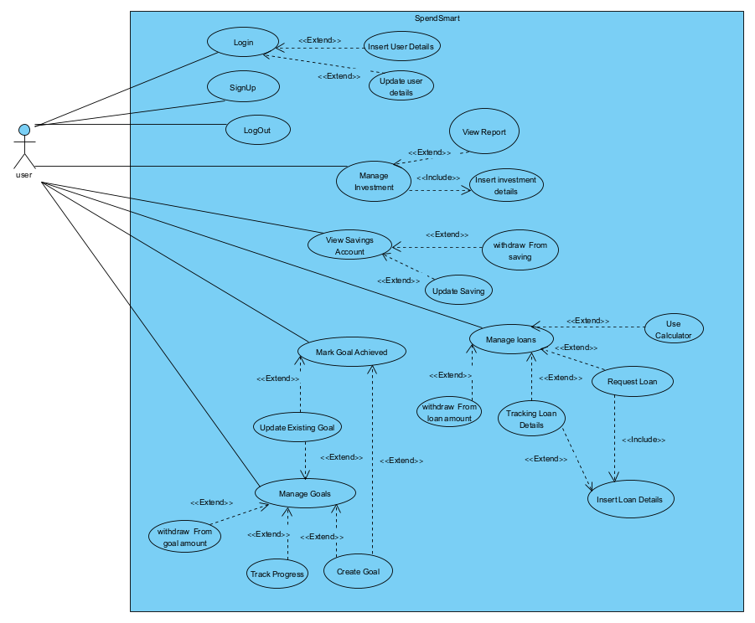
Use Case
15

Slide 16
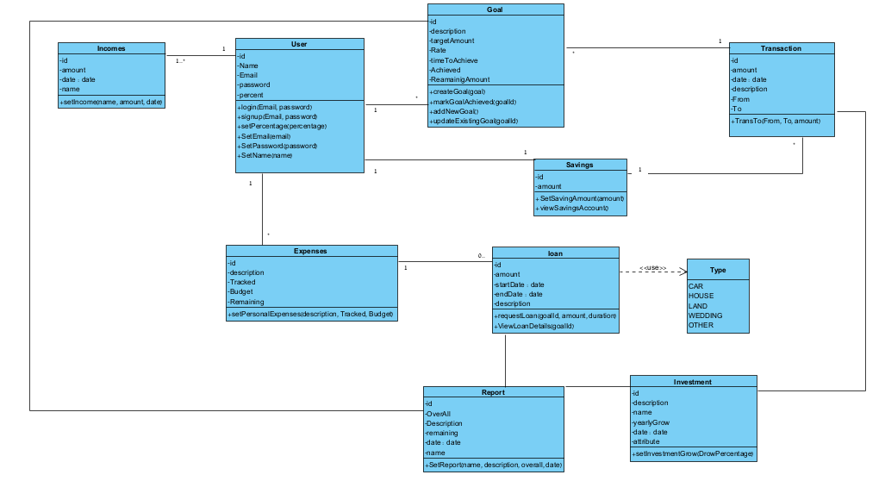
Class Diagram
16

Slide 17
GUI
06
17

Slide 18
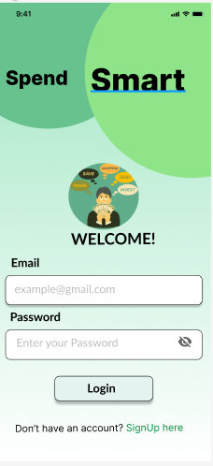
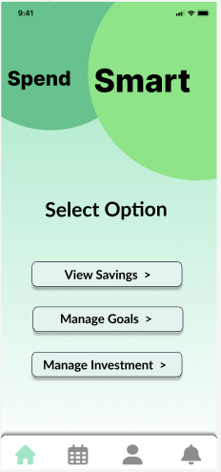
GUI
18

Slide 19
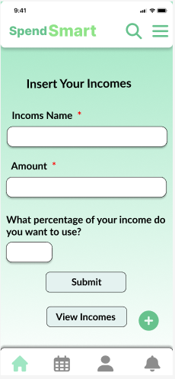
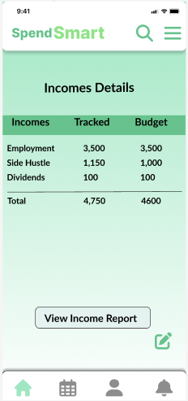
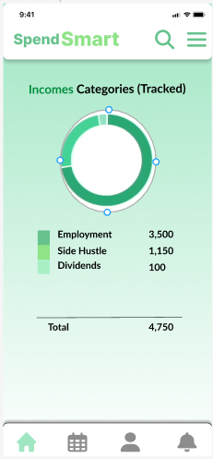
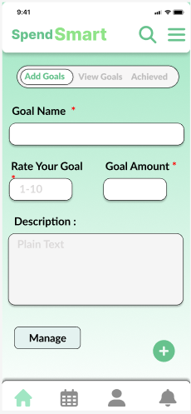
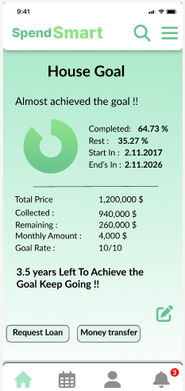
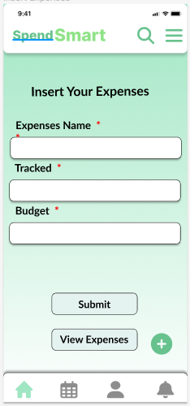
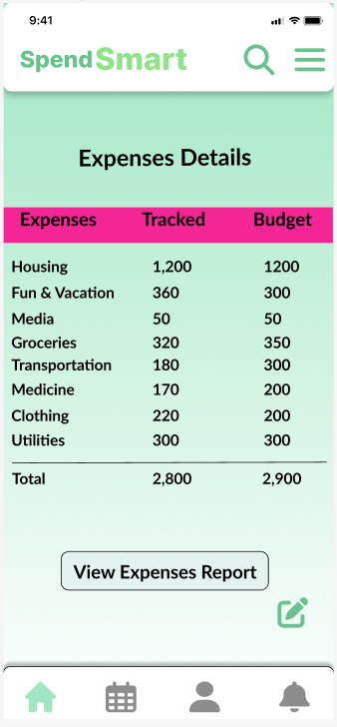
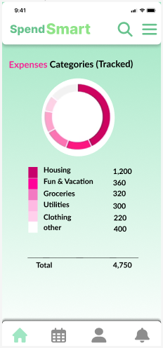
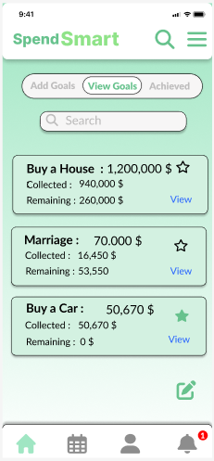
19

Slide 20
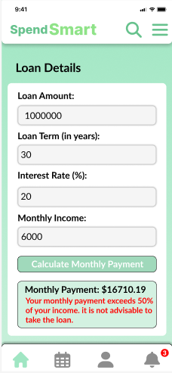
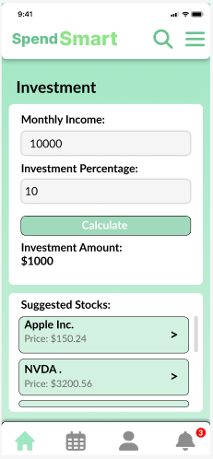
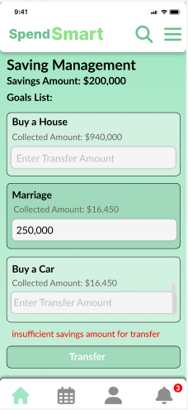
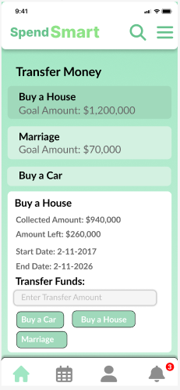
20

Slide 21
Test Plans
07
21

Slide 22
Login Tests
Comment | Precondition | Expected Result | Description | Test Name
This test ensures that the login functionality is working correctly and allows users to access their accounts securely. | User account exists in the system with valid login credentials. | The user should be granted access to their account dashboard. | This test verifies that a user can successfully log in with valid credentials. | Successful Login
This test ensures that the application properly handles failed login attempts and provides appropriate feedback to the user. | User account exists in the system with a valid username but an incorrect password. | The application should display an error message indicating that the password is incorrect. | This test checks if the application rejects login attempts with an incorrect password. | Failed Login - Incorrect Password
This test ensures that the application handles invalid usernames correctly and prompts the user to enter a valid username. | User attempts to log in with a username that does not exist in the system. | The application should display an error message indicating that the username is not recognized. | This test verifies that the application rejects login attempts with an invalid username. | Failed Login - Invalid Username
This test ensures that the application enforces the requirement for a username and provides appropriate validation. | User attempts to log in without entering a username. | The application should display an error message indicating that the username is required. | This test checks if the application handles login attempts without entering a username. | Failed Login - Missing Username
This test ensures that the application enforces the requirement for a password and prompts the user to enter it. | User attempts to log in without entering a password. | The application should display an error message indicating that the password is required. | This test verifies that the application requires the user to enter a password for login. | Failed Login - Missing Password
22

Slide 23
Goal Management Tests
Comment | Precondition | Expected Result | Description | Test Name
This test ensures that the goal creation functionality is working correctly and allows users to define their financial objectives. | User is logged in and on the goal management page. | The goal should be added to the user's goal list. | This test verifies that a user can successfully create a new goal. Expected Result: The goal should be added to the user's goal list. | Create Goal
This test ensures that the application correctly calculates the progress towards each goal based on the allocated amount and the monthly contributions. | User has a goal created and has made contributions towards it. | The goal progress should be updated based on the user's monthly contributions and the assigned rate. | This test checks if the application accurately tracks and updates the progress of a goal. | Update Goal Progress
This test ensures that the application allows users to remove goals that they no longer wish to pursue. | User has a goal created and is on the goal management page. | The goal should be removed from the user's goal list. | This test verifies that the user can delete a goal from their goal list. Expected Result: The goal should be removed from the user's goal list. | Delete Goal
This test ensures that the application enables users to set new financial objectives once they have accomplished previous goals. | User has achieved a goal and is on the goal management page. | The new goal should be added to the user's goal list. | This test checks if the user can add a new goal after achieving a previous goal. | Add New Goal
This test ensures that the application correctly captures and stores the desired amount for each goal, representing the target to be achieved. | User has a goal created and is on the goal management page. | The goal amount should be saved and associated with the goal. | This test verifies that the user can specify the target amount for a goal. | Set Goal Amount
This test ensures that the application correctly captures and stores the rate for each goal, which determines the contribution towards the goal each month. | User has a goal created and is on the goal management page. | The goal rate should be saved and associated with the goal. | This test checks if the user can set a rate for a specific goal. | Set Goal Rate
23

Slide 24
This test ensures that the budgeting algorithm considers the user's income, rates, and desired goal amounts to determine the monthly allocation for each goal. | User has set goals with rates, desired amounts, and income entered. | The allocation amount for each goal should be calculated accurately. | This test verifies that the budgeting algorithm updates the allocation amount for each goal based on the user's income, rate, and desired goal amount. | Update Goal Allocation
This test ensures that the budgeting algorithm correctly calculates the total allocation amount and ensures that it does not exceed the user's income. | User has set goals with rates, desired amounts, and income entered. | The total allocation amount should equal the user's income. | This test checks if the total allocation amount for all goals matches the user's income. | Check Monthly Allocation Total
This test ensures that the budgeting algorithm accurately updates the goal amount based on the allocated monthly contributions, providing an updated target for goal achievement. | User has set goals with rates, desired amounts, and income entered. | The goal amount to be achieved should reflect the updated monthly contributions. | This test verifies that the goal amount to be achieved is updated correctly based on the allocated monthly amounts and the desired goal amount. | Validate Updated Goal Amount
This test ensures that the budgeting algorithm can adapt to changes in the user's income and recalculates the allocation amounts accordingly. | User has set goals with rates, desired amounts, and initial income entered. User updates the income value. | The allocation amounts for each goal should be recalculated based on the new income value. | This test checks if the budgeting algorithm adjusts the allocation amounts when the user's income changes. | Handle Changes in Income
24

Slide 25
Loan Part Tests
Comment | Precondition | Expected Result | Description | Test Name
This test ensures that the loan calculation algorithm correctly determines the monthly payment and total repayment amount based on the input values. | User has entered a loan amount, interest rate, and loan term. | The calculated monthly payment and total repayment amount should match the expected values. | This test verifies that the loan calculation is accurate based on the loan amount, interest rate, and loan term. | Loan Calculation Accuracy
This test ensures that the loan eligibility check algorithm properly assesses the user's financial situation and goals to determine if they meet the criteria for obtaining a loan. | User has provided their financial information and goals. | The application should display an error message indicating that the password is incorrect. | This test checks if the application correctly determines the user's eligibility for a loan based on their financial situation and goals. | Loan Eligibility Check
This test ensures that the loan details are correctly stored and retrieved, providing the user with an accurate overview of the loan terms and repayment information. | User has entered loan details and received loan offers. | The loan details displayed should match the information entered by the user and the calculated values. | This test checks if the application accurately displays all relevant details of a loan, including the monthly payment amount, interest rate, loan term, and total repayment amount. | Loan Details Display
25

Slide 26
Investment Part Tests
Comment | Precondition | Expected Result | Description | Test Name
calculates and allocates the desired percentage of income for investments. | User has specified the percentage of income to allocate towards investments. | The allocated investment amount should match the user's specified percentage of income. | This test verifies that the application accurately allocates the user's chosen percentage of income to investments. | Investment Allocation
This test ensures that the application accurately updates the user's income by deducting the allocated percentage for investments. | User has specified the percentage of income to allocate towards investments and has a valid income value. | The user's income should be reduced by the allocated percentage for investments. | This test verifies that the user's income is correctly updated after allocating a percentage for investments. | Income Update After Investment Allocation
26

Slide 27






Challenges
Algorithm Complexity
Complex Bugs
Integration Complexity
Time Management
Design Considerations
27

Slide 28
Video
09
28

Slide 29
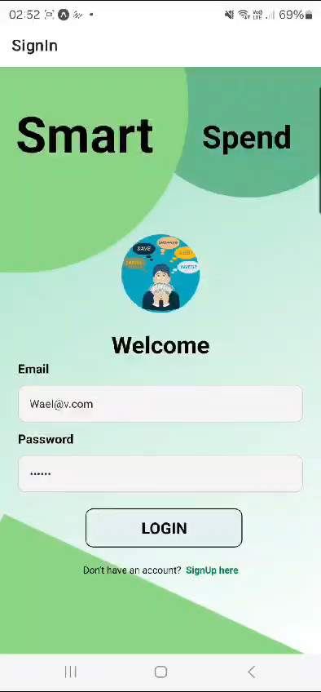
Our Financial Management App
Presenting the video of our financial management app. We hope you enjoy it!

Slide 30

THANK YOU
Do you have any questions?

